Slide 1
The Institutional Context
of Multinational Management

Slide 2
Learning Objectives (1 of 3)
Understand the national context and how it affects the business environment.
Understand the influence of the institutional context of countries on individuals and organizations.
Define social institutions and understand their basic forms.
Explain how social institutions influence both people and organizations.

Slide 3
Learning Objectives (2 of 3)
Describe the basic economic systems and their influence on multinational operations.
Understand the basic stages of industrialization and their implications for multinationals.
Discuss the world’s basic religions and how they shape the local business environment.
Develop an understanding of education and its effects on multinational operations.

Slide 4
Learning Objectives (3 of 3)
Define social inequality and its implications for multinationals.
Understand the importance of the national context and its connection with other international management areas.

Slide 5
Institutional Context (1 of 2)
Institutional Context: Includes other elements of society besides national culture such as:
  Education
  The government
  The legal system
These can affect important business-related differences among societies.
May encourage adoption of values inconsistent with national cultures.

Slide 6
Institutional Context (2 of 2)
It is important to understand the dominant institutional context of any society, and appreciate its influence on individuals and organizations.
Understanding the institutional context is critical to effective multinational management.
At a basic level, a manager cannot completely understand any society without examining its national culture and institutional context.

Slide 7
National Context
National Context: The national context is composed of the respective national cultures and social institutions of a society.
Intertwined with national cultural forces are social institutions such as:
  The economic system
  Religion
  Education

Slide 8
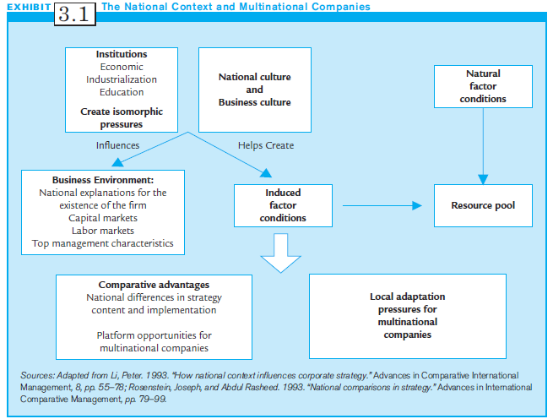
Exhibit 3.1:
The National Context and Multinational Companies

Slide 9
Social Institutions
Social Institutions: may be defined as:
  a complex of positions, roles, norms, and values lodged in particular types of social structures, and
  organizing stable patterns of human resources regarding fundamental problems in sustaining viable societal structures within a given environment.
Social institutions have profound effects on people’s life conditions, and provide context for psychological differences among people.

Slide 10
Key Social Institutions that Influence Organizations
Three key social institutions that influence business environment:
  The economic system
  The level of industrialization
  Types of religions
Additionally,
  Education
  Level of social inequality

Slide 11
Economic Systems (1 of 3)
Economic systems: network or system of beliefs, activities, organizations and relationships that provide the goods and services of a society
Typified by extremes of capitalism, socialism and a mix of both
Important implications based on
  Dominant market type
  Market transitions

Slide 12
Economic Systems (2 of 3)
Capitalist/market economy: production is decentralized to private property rights owners who act to make profits in competitive market
Socialist/command economy: production resources are owned by the state, and production decisions are centrally coordinated
Mixed economy: combines aspects of capitalist and socialist economies
  E.g., Sweden, France, Denmark, Italy and India

Slide 13
Economic Systems (3 of 3)
Economic systems have two major implications for strategic multinational management:
  Dominant market type
  Market transitions

Slide 14
Dominant Market Type
Dominant Market Type: Whether the market and economic system of a country are predominantly capitalist, socialist or mixed.
The decision whether to operate in another country may depend on the dominant market type.
In mixed economies, MNCs should subordinate their economic goals and respect social objectives
Multinational managers may want to consider the Index of Economic Freedom.

Slide 15
Index of Economic Freedom
Index of Economic Freedom: Defines economic freedom as:
  The absence of government coercion or constraint on the production, distribution, or consumption of goods and services beyond the extent necessary for citizens to protect and maintain liberty itself
The index includes 10 indicators ranging from trade and taxation policies, to property rights and regulation, including government intervention in the economy.

Slide 16
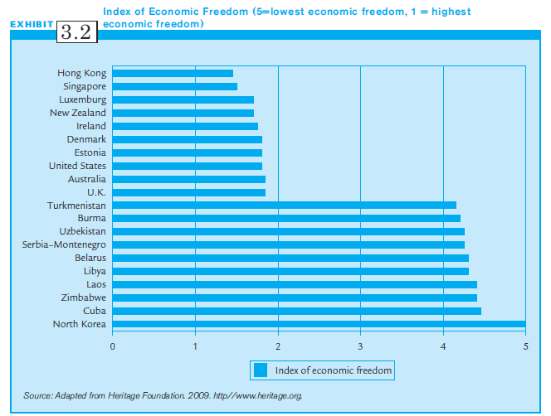
Exhibit 3.2:
Index of Economic Freedom

Slide 17
Market Transitions
Market Transitions: Changes societies experience as they move from socialism to a market based economy
Multinational implications:
  Need to turn around inefficient formerly state-owned companies to become cost effective
  Motivational issues with workers
  Interpersonal trust, teams, meritocracy

Slide 18
Industrialization (1 of 2)
Industrialization: Cultural and economic changes that occur because of how production is organized and distributed in society
Stages of industrialization
  Pre-industrial
  Industrial
  Postindustrial

Slide 19
Industrialization (2 of 2)
Pre-industrial society:
  Agriculture dominates the economic environment
  Religious norms, tradition emphasized
Industrial society:
  Dominance of manufacturing or secondary sector
  Technological development
Postindustrial society:
  Emphasis on the service sectors
  Need highly skilled workers with specialized skills

Slide 20
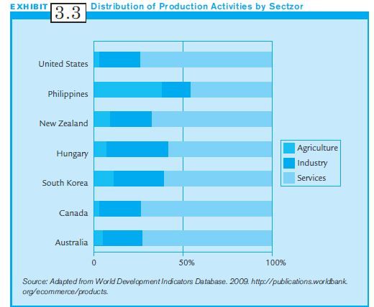
Exhibit 3.3: Selected countries and the distribution of employment by primary, secondary and tertiary sectors

Slide 21
Managerial Implications:
Industrialization
(1 of 2)
Direct correspondence between industrialization and economic development
Pre-industrial countries provide cheap labor and untapped markets
  But poor infrastructure for business
  Traditional and communal values that are highly influenced by religious norms
Industrial societies favor innovation and individualism
  Governments provide favorable environment
  Educated labor force

Slide 22
Managerial Implications:
Industrialization
(2 of 2)
Postindustrial societies
  Dominance of service sector; knowledge based
  Almost complete demise of agricultural sector
  Significant decline in manufacturing sector
  Increasing emphasis on quality-of-life
  Non economic incentives favored
  Post-materialist values, individual expression, and movement toward more a humane society

Slide 23
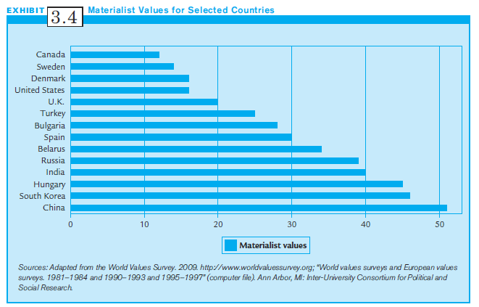
Exhibit 3.4:
Materialist Values for Selected Countries

Slide 24
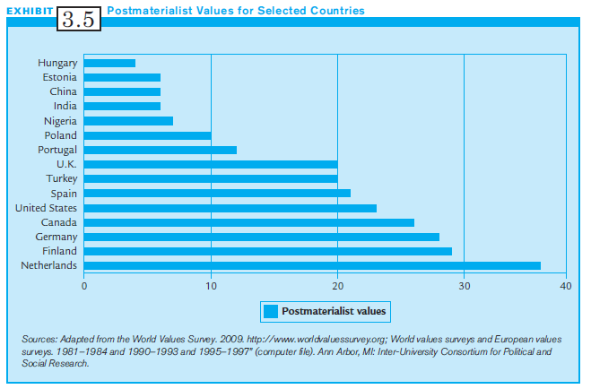
Exhibit 3.5:
Postmaterialist Values for Selected Countries

Slide 25
Religion
Religion: A shared set of beliefs, activities, and institutions based on faith in supernatural forces.
Religion is an important aspect of most societies.
Together, Christianity, Islam, Hinduism and Buddhism are followed by almost 71% of the world’s population.
20% of world’s population are nonreligious.
Different religions shape how people do business in different parts of the world.

Slide 26
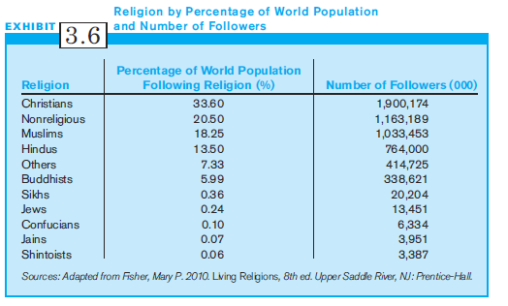
Exhibit 3.6:
Religion by Percentage of World Population & Number of Followers

Slide 27
Christianity
Christianity: A religion based on the teachings of Jesus
  The most practiced religion around the world
  Protestantism emphasizes wealth and hard work
  Ten commandments – basis for ethical behaviors
  Dignity of human life, labor and happiness
Implications for multinationals:
  Business environment conducive to these values
  Sunday holiday for prayer

Slide 28
Islam
Islam: Based on submission to the will of Allah (God).
  The Prophet Muhammad was a messenger of Allah.
  The second largest of the world’s religions and growing.
  Islamic laws or Shari’ah, based on The Five Pillars.
  Muslims pray five times a day, fast during Ramadan.
Implications for multinationals:
  Islam prohibits profiting by exploiting others.
  Islam prohibits the payment or receipt of interest.
  Limited role for women in some Islamic societies.

Slide 29
Hinduism (1 of 2)
Hinduism: A broad and inclusive religion with no single founder
Based on the Vedic scriptures
Oldest, embodied in the ancient traditions of India
  Currently 760 million Hindus worldwide
  Quest for ultimate reality and truth
  Hindus live life according to the principles of Dharma (righteousness and moral order)
  Belief in Karma and reincarnation

Slide 30
Hinduism (2 of 2)
Implications for multinationals:
  Spiritual achievement is an important value
  Respect for elders, age and wisdom
  Hinduism has clear guidelines for ethical behavior
  Inequality in caste system, social structure of India

Slide 31
Buddhism
Buddhism: A religious tradition that focuses on the reality of world suffering and the ways one can be freed from suffering
Craving and desires produce suffering
Dominant religion in Asia
Implications for multinationals
  Encourages hard work; laziness seen as negative
  Emphasizes teamwork; all beings are interconnected

Slide 32
Education
Education: organized networks of socialization experiences which prepare individuals to act in society
Central element in organization of society
Helps construct competencies, professions, and professionals

Slide 33
Managerial Implications:
Education
Gives an idea of the skill level of workers in any society
The more educated, the more skills workers have
Multinationals can look at educational attainment scores to determine the nature of the workforce
Other scores relevant:
  Math and Science
  R & D expenditure

Slide 34
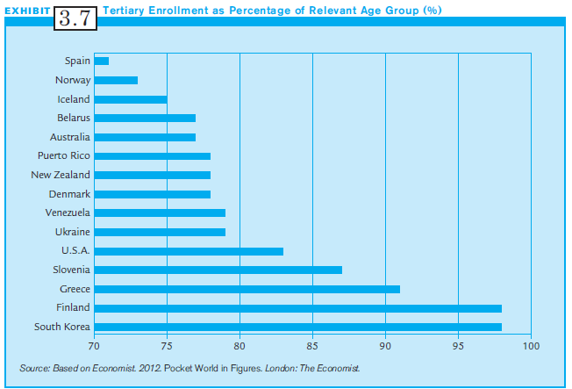
Exhibit 3.7:
Tertiary Enrollment as
Percentage of Relevant Age Groups

Slide 35
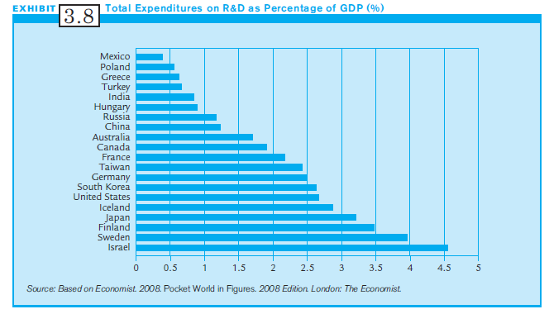
Exhibit 3.8:
Total Expenditures on R&D as Percentage of GDP

Slide 36
Social Inequality
Social Inequality: Refers to the degree to which people have privileged access to resources and positions within societies.
In societies that have high social inequality, a few individuals have the ability to control and use important resources.
These select few use access to resources to acquire more power, thereby perpetuating inequality.
Social inequality negatively impacts the degree to which people are attached to work.

Slide 37
Managerial Implications:
Social Inequality
Many MNCs are facing significant criticisms for their operations in countries with high social inequalities
  Criticized for paying low wages, using child labor.
  Realizing social responsibility is also in their own interests.
Implications for Management:
  Many key ethical issues arise in such countries.
  Consider the GINI Index on the degree of social inequality.
  Recognize that social inequality yields more demoralized workers, suspicious of management.

Slide 38
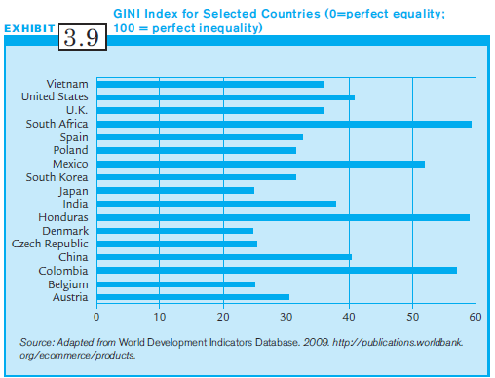
Exhibit 3.9:
The GINI Index for
Selected Countries

Slide 39
Summary
To understand a society, it is essential to understand both its national culture and institutional context.
Social institutions affect individuals and organizations.
Differing economic systems have major implications for multinational strategic management.
The degree of industrialization of a society is linked to its economic development.
Religion, education & social inequality also impact multinational management strategy.

